Slide 1

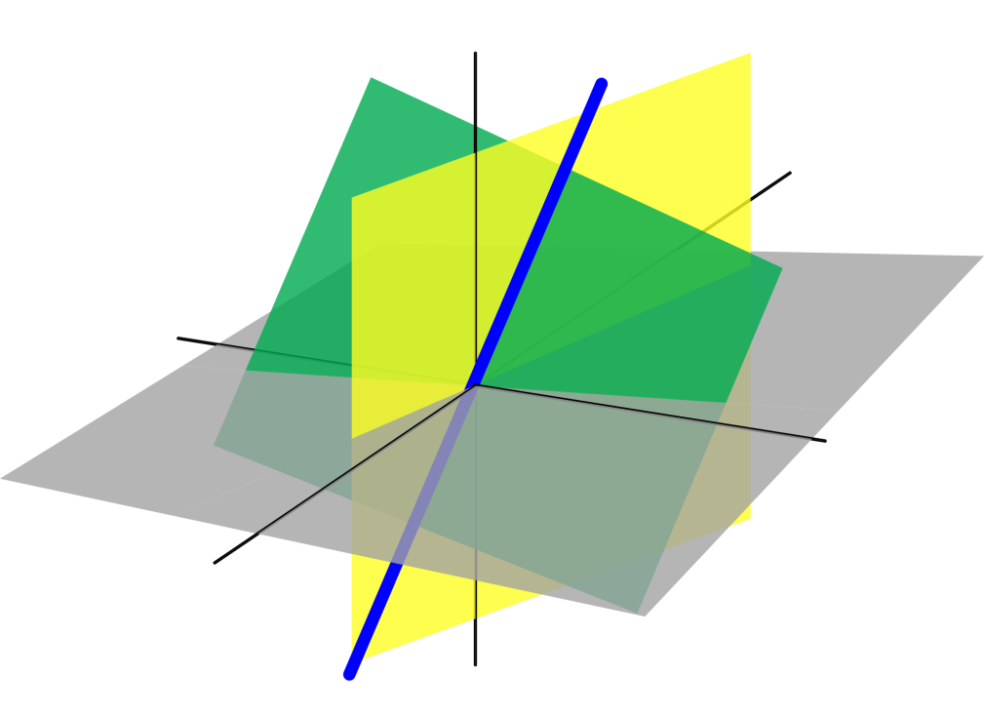
Azərbaycan Dövlət Neft və Sənaye Universiteti
Linear Algebra

Slide 2
In our previous lessons we used matrices to solve systems of linear equations.
Matrices, however, can be used to do much more than that.
There is a rich mathematical theory of matrices, and its applications are numerous.
Operations with Matrices

Slide 3
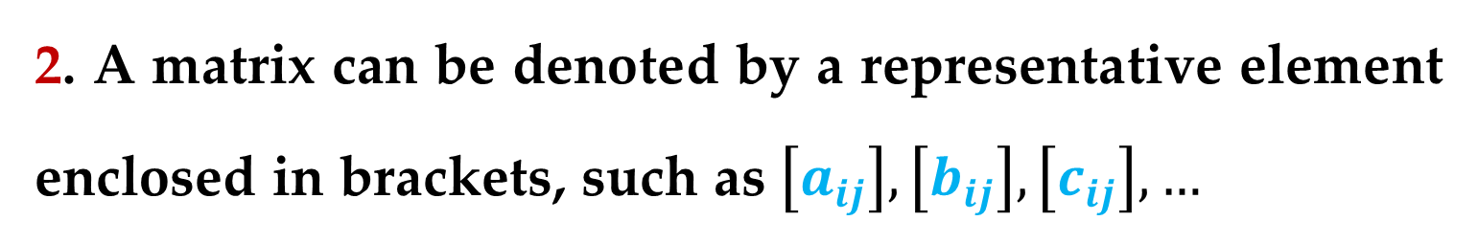
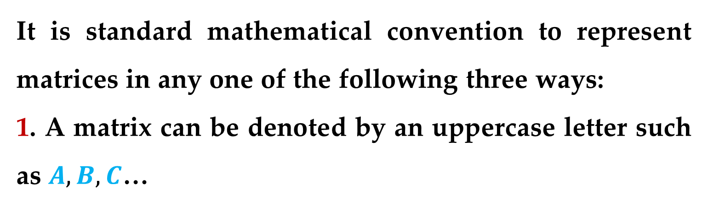
It is standard mathematical convention to represent matrices in any one of the following three ways:
1. A matrix can be denoted by an uppercase letter such as $A, B, C$…
2. A matrix can be denoted by a representative element enclosed in brackets, such as $\left[a_{ij}\right],\left[b_{ij}\right],\left[c_{ij}\right],…$
3. A matrix can be denoted by a rectangular array of numbers
Operations with Matrices

Slide 4
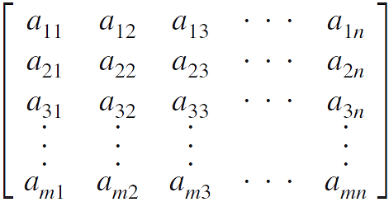
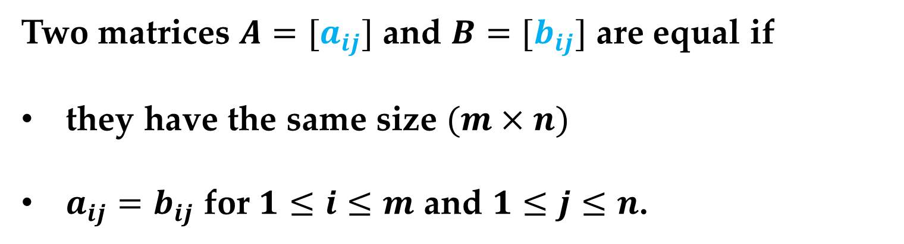
Definition. Equality of Matrices
Two matrices $A=[a_{ij}]$ and $B=[b_{ij}]$ are equal if
they have the same size $(m×n)$
$a_{ij}=b_{ij}$ for $1≤i≤m$ and $1≤j≤n$.
Operations with Matrices

Slide 5
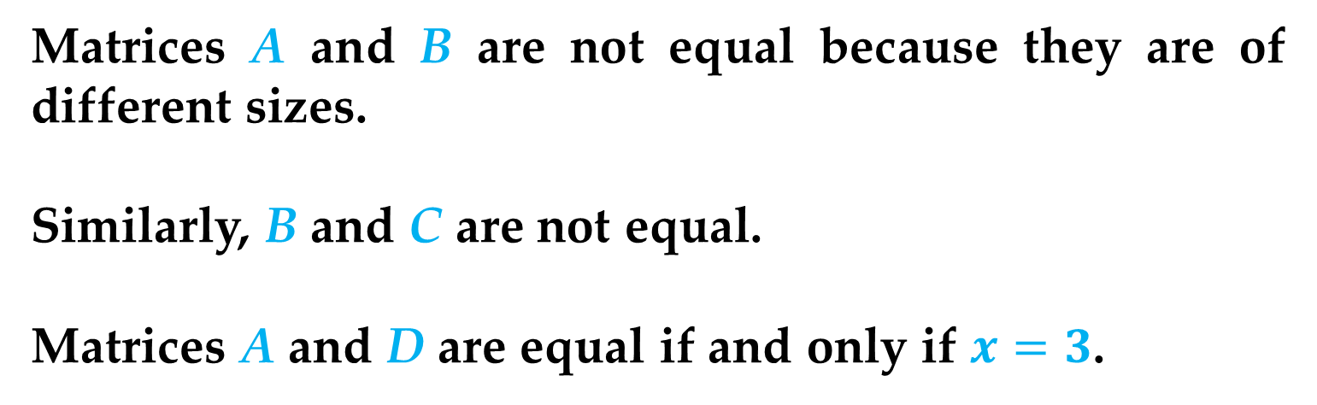
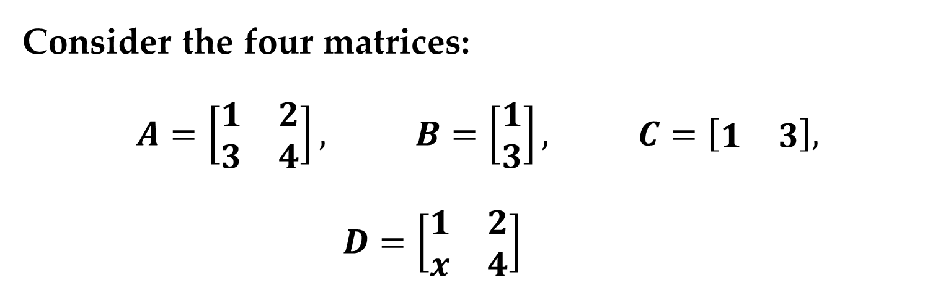
Example 1. Equality of Matrices
Consider the four matrices:
$$A=\left[\begin{matrix}1 & 2 \\ 3 & 4\end{matrix}\right], B=\left[\begin{matrix}1 \\ 3\end{matrix}\right], C=\left[\begin{matrix}1 & 3\end{matrix}\right], D=\left[\begin{matrix}1 & 2 \\ x & 4\end{matrix}\right]$$
Matrices A and B are not equal because they are of different sizes.
Similarly, B and C are not equal.
Matrices A and D are equal if and only if $x=3$.
Operations with Matrices

Slide 6
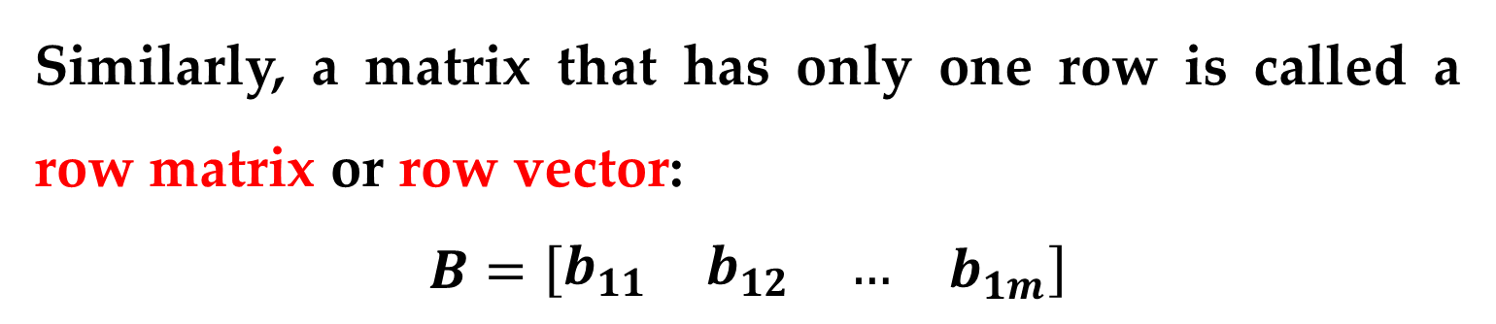
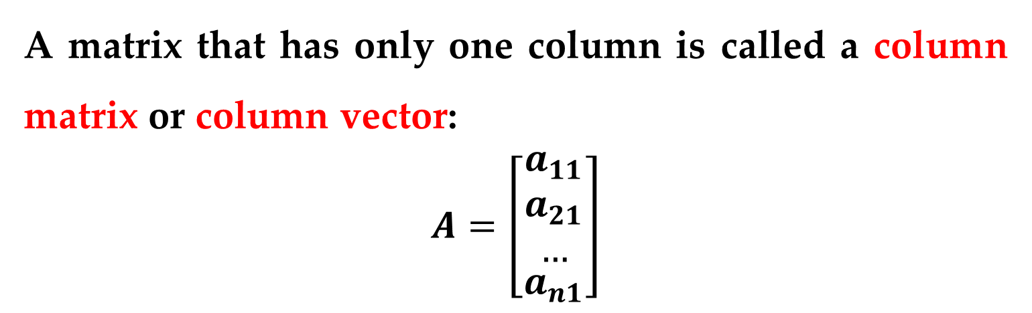
Definition
A matrix that has only one column is called a column matrix or column vector:
$$A=\left[\begin{matrix}\begin{matrix}a_{11} \\ a_{21} \\ …\end{matrix} \\ a_{n1}\end{matrix}\right]$$
Similarly, a matrix that has only one row is called a row matrix or row vector:
$$B=\left[\begin{matrix}\begin{matrix}b_{11} & b_{12} & …\end{matrix} & b_{1m}\end{matrix}\right]$$
Operations with Matrices

Slide 7
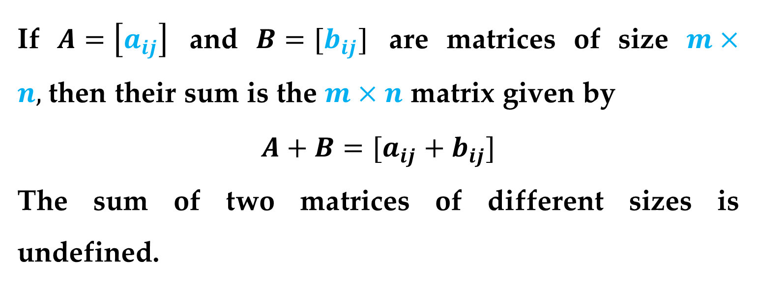
You can add two matrices of the same size by adding their corresponding entries.
Definition (Matrix Addition)
If $A=\left[a_{ij}\right]$ and $B=[b_{ij}]$ are matrices of size $m×n,$then their sum is the $m×n$ matrix given by
$$A+B=[a_{ij}+b_{ij}]$$
The sum of two matrices of different sizes is undefined.
Matrix Addition

Slide 8
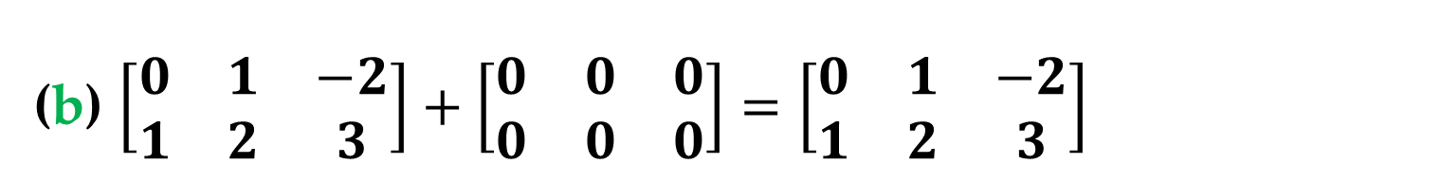
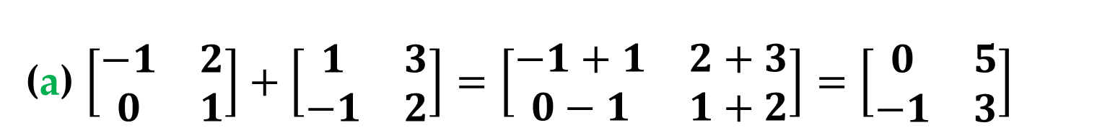
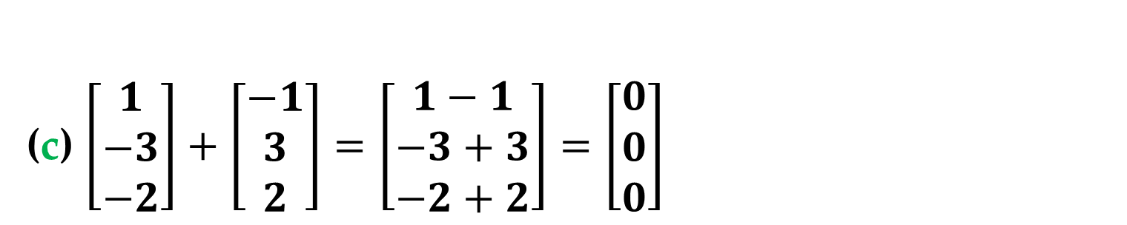
Example 2. Addition of Matrices
(a) $\left[\begin{matrix}−1 & 2 \\ 0 & 1\end{matrix}\right]+\left[\begin{matrix}1 & 3 \\ −1 & 2\end{matrix}\right]=\left[\begin{matrix}−1+1 & 2+3 \\ 0−1 & 1+2\end{matrix}\right]=\left[\begin{matrix}0 & 5 \\ −1 & 3\end{matrix}\right]$
(b) $\left[\begin{matrix}0 & 1 & −2 \\ 1 & 2 & 3\end{matrix}\right]+\left[\begin{matrix}0 & 0 & 0 \\ 0 & 0 & 0\end{matrix}\right]=\left[\begin{matrix}0 & 1 & −2 \\ 1 & 2 & 3\end{matrix}\right]$
(c) $\left[\begin{matrix}1 \\ −3 \\ −2\end{matrix}\right]+\left[\begin{matrix}−1 \\ 3 \\ 2\end{matrix}\right]=\left[\begin{matrix}1−1 \\ −3+3 \\ −2+2\end{matrix}\right]=\left[\begin{matrix}0 \\ 0 \\ 0\end{matrix}\right]$
Matrix Addition

Slide 9
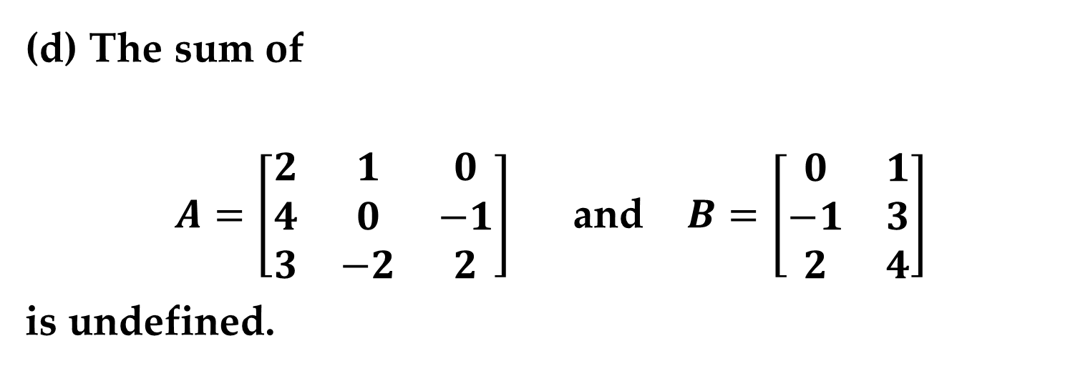
Example 2. Addition of Matrices
(d) The sum of
$A=\left[\begin{matrix}2 & 1 & 0 \\ 4 & 0 & −1 \\ 3 & −2 & 2\end{matrix}\right]$ and $B=\left[\begin{matrix}0 & 1 \\ −1 & 3 \\ 2 & 4\end{matrix}\right]$
is undefined.
Matrix Addition

Slide 10
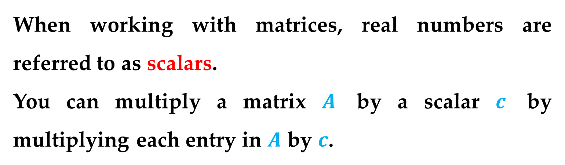
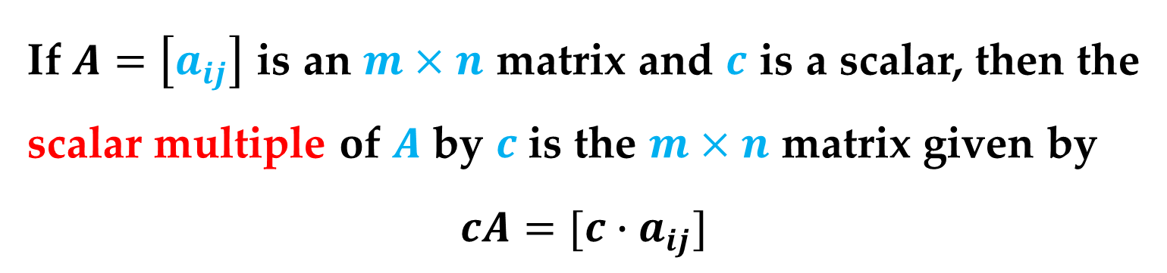
When working with matrices, real numbers are referred to as scalars.
You can multiply a matrix $A$ by a scalar $c$ by multiplying each entry in $A$ by $c$.
Definition (Scalar Multiplication)
If $A=\left[a_{ij}\right]$ is an $m×n$ matrix and $c$ is a scalar, then the scalar multiple of $A$ by $c$ is the $m×n$ matrix given by
$$cA=[c∙a_{ij}]$$
Scalar Multiplication

Slide 11
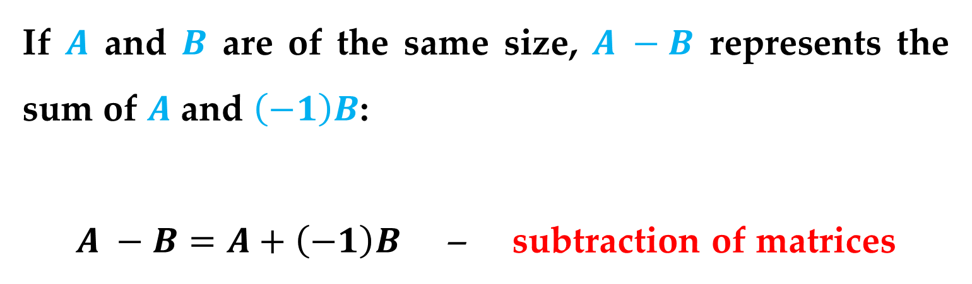
Remark
You can use $−A$ to represent the scalar product $\left(−1\right)A$.
If $A$ and $B$ are of the same size, $A −B$ represents the sum of $A$ and $\left(−1\right)B$:
$A −B=A+\left(−1\right)B$ – subtraction of matrices
Scalar Multiplication

Slide 12
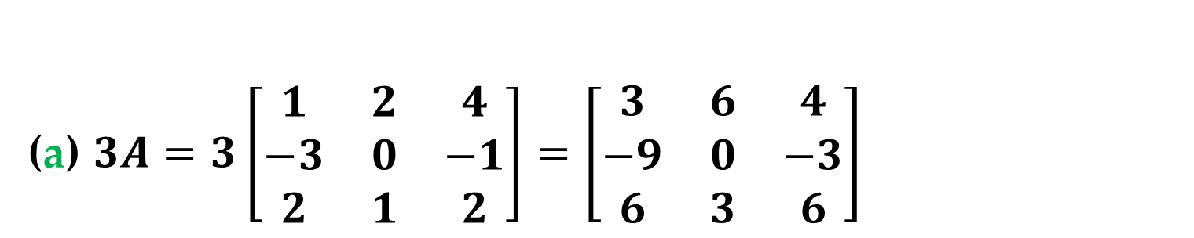
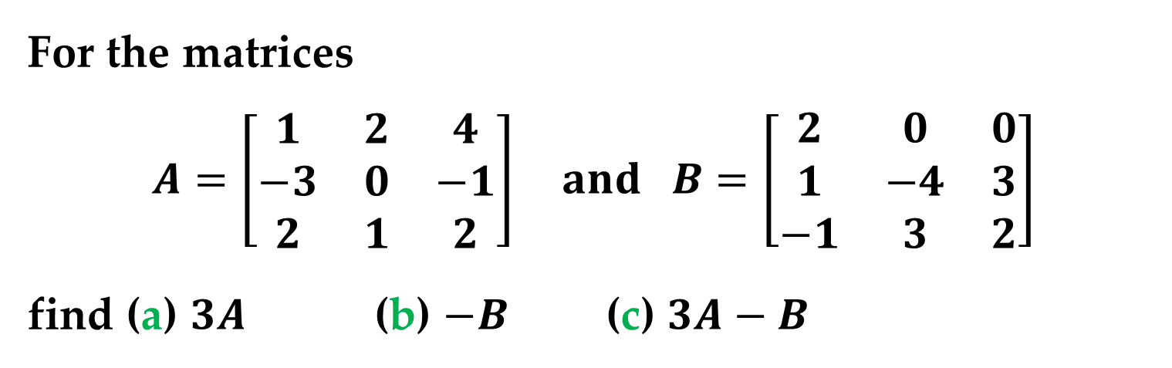
Example 3. Scalar Multiplication and Matrix Subtraction
For the matrices
$$A=\left[\begin{matrix}1 & 2 & 4 \\ −3 & 0 & −1 \\ 2 & 1 & 2\end{matrix}\right] and B=\left[\begin{matrix}2 & 0 & 0 \\ 1 & −4 & 3 \\ −1 & 3 & 2\end{matrix}\right]$$
find (a) $3A$ (b) $−B$ (c) $3A−B$
Solution
(a) $3A=3\left[\begin{matrix}1 & 2 & 4 \\ −3 & 0 & −1 \\ 2 & 1 & 2\end{matrix}\right]=\left[\begin{matrix}3 & 6 & 4 \\ −9 & 0 & −3 \\ 6 & 3 & 6\end{matrix}\right]$
Scalar Multiplication

Slide 13
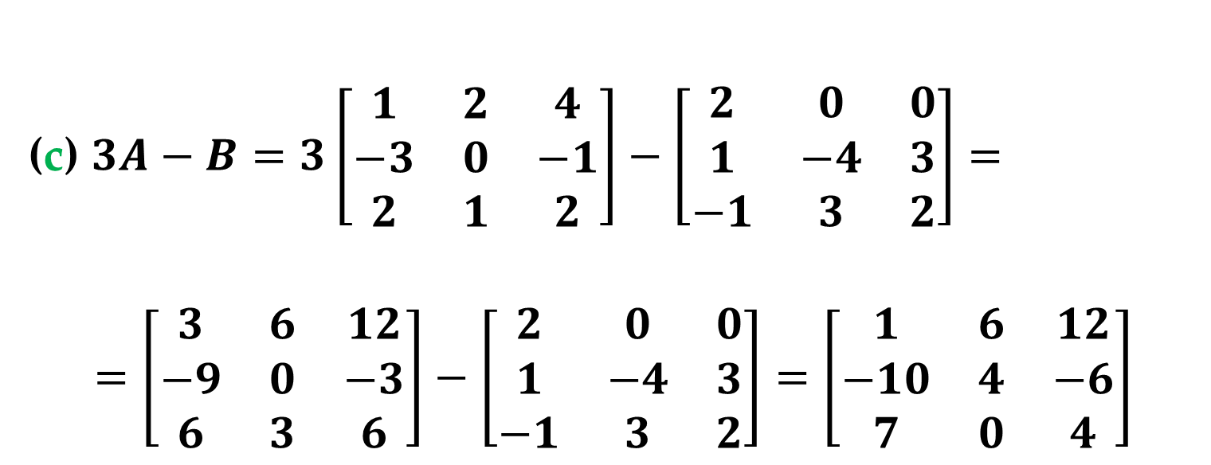
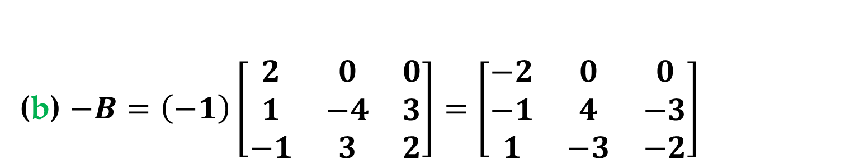
Solution (continued)
(b) $−B=\left(−1\right)\left[\begin{matrix}2 & 0 & 0 \\ 1 & −4 & 3 \\ −1 & 3 & 2\end{matrix}\right]=\left[\begin{matrix}−2 & 0 & 0 \\ −1 & 4 & −3 \\ 1 & −3 & −2\end{matrix}\right]$
(c) $3A−B=3\left[\begin{matrix}1 & 2 & 4 \\ −3 & 0 & −1 \\ 2 & 1 & 2\end{matrix}\right]−\left[\begin{matrix}2 & 0 & 0 \\ 1 & −4 & 3 \\ −1 & 3 & 2\end{matrix}\right]=$
$$=\left[\begin{matrix}3 & 6 & 12 \\ −9 & 0 & −3 \\ 6 & 3 & 6\end{matrix}\right]−\left[\begin{matrix}2 & 0 & 0 \\ 1 & −4 & 3 \\ −1 & 3 & 2\end{matrix}\right]=\left[\begin{matrix}1 & 6 & 12 \\ −10 & 4 & −6 \\ 7 & 0 & 4\end{matrix}\right]$$
Scalar Multiplication

Slide 14
The third basic matrix operation is matrix multiplication.
Let’s consider the following application in which matrices are helpful for organizing information.
Problem
A football stadium has three concession areas, located in the south, north, and west stands.
The top-selling items are peanuts, hot dogs, and soda.
Matrix Multiplication

Slide 15
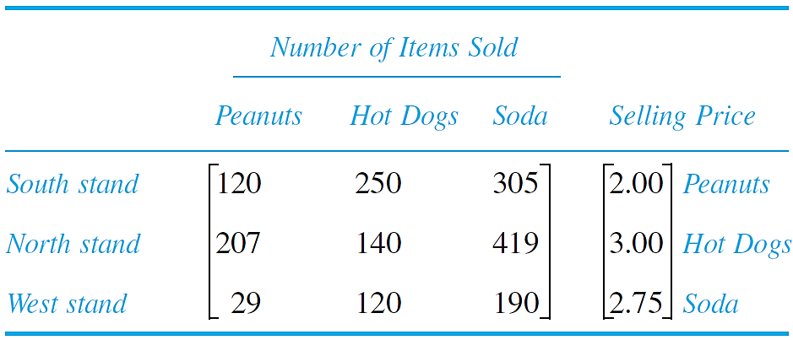
Sales for a certain day are recorded in the first matrix below, and the prices (in dollars) of the three items are given in the second matrix.
Matrix Multiplication

Slide 16
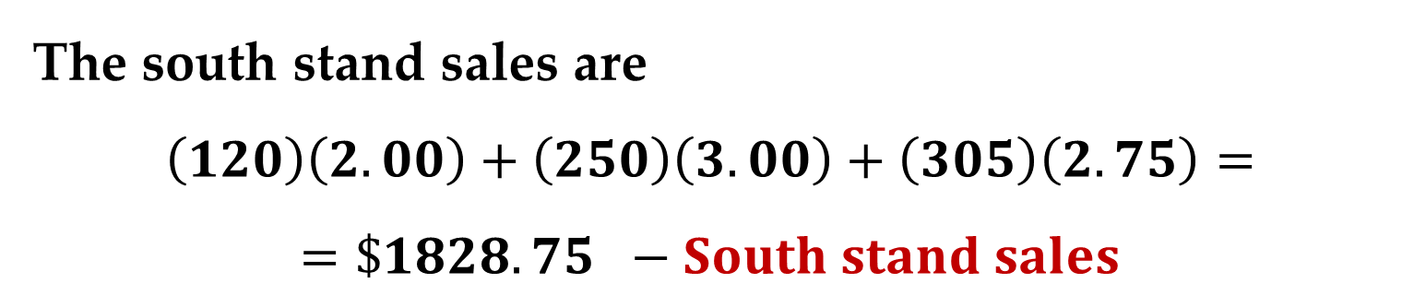
Solution
To calculate the total sales of the three top-selling items at the south stand, you can multiply each entry in the first row of the matrix on the left by the corresponding entry in the price column matrix on the right and add the results.
The south stand sales are
$$\left(120\right)\left(2.00\right)+\left(250\right)\left(3.00\right)+\left(305\right)\left(2.75\right)=$$
$$=\$1828.75 −South stand sales$$
Matrix Multiplication

Slide 17
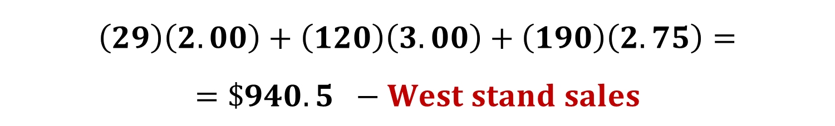
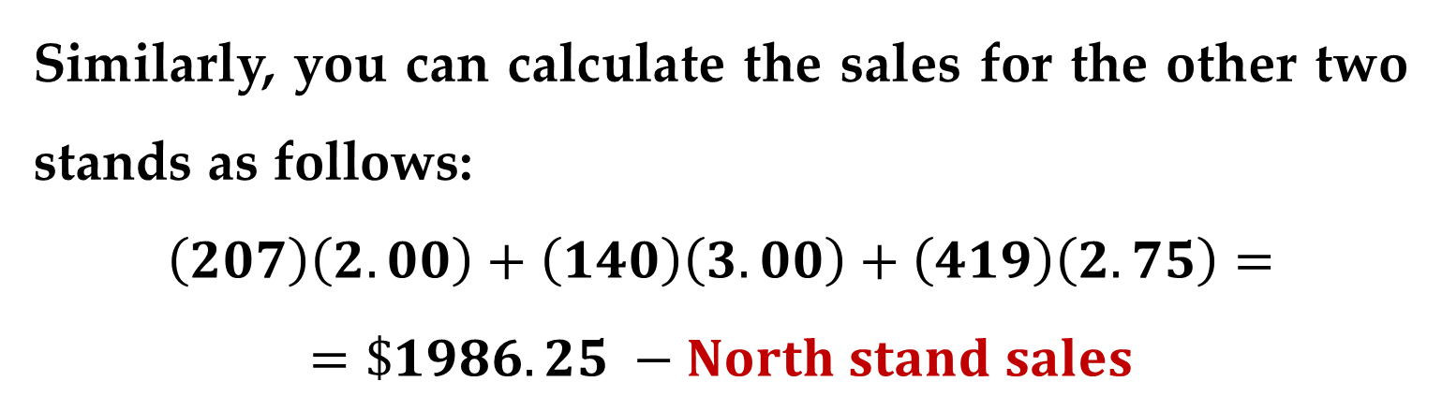
Solution (continued)
Similarly, you can calculate the sales for the other two stands as follows:
$$\left(207\right)\left(2.00\right)+\left(140\right)\left(3.00\right)+\left(419\right)\left(2.75\right)=$$
$$=\$1986.25 −North stand sales$$
$$\left(29\right)\left(2.00\right)+\left(120\right)\left(3.00\right)+\left(190\right)\left(2.75\right)=$$
$$=\$940. 5 −West stand sales$$
Matrix Multiplication

Slide 18
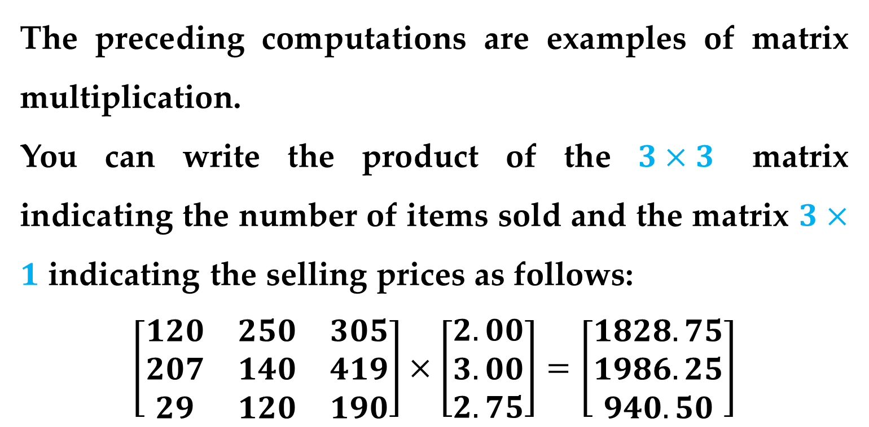
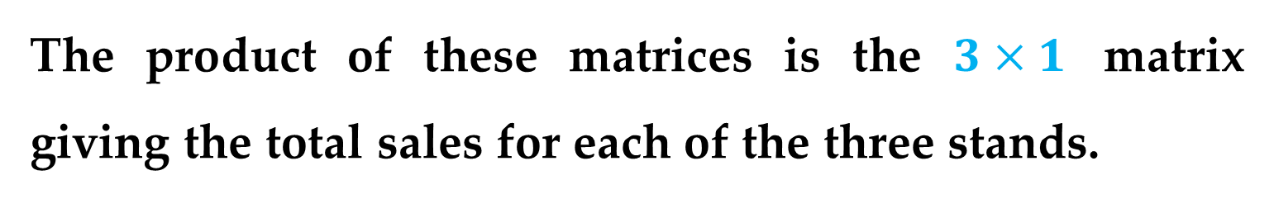
The preceding computations are examples of matrix multiplication.
You can write the product of the $3×3$ matrix indicating the number of items sold and the matrix $3×1$ indicating the selling prices as follows:
$$\left[\begin{matrix}120 & 250 & 305 \\ 207 & 140 & 419 \\ 29 & 120 & 190\end{matrix}\right]×\left[\begin{matrix}2.00 \\ 3.00 \\ 2.75\end{matrix}\right]=\left[\begin{matrix}1828.75 \\ 1986.25 \\ 940.50\end{matrix}\right]$$
The product of these matrices is the $3×1$ matrix giving the total sales for each of the three stands.
Matrix Multiplication

Slide 19
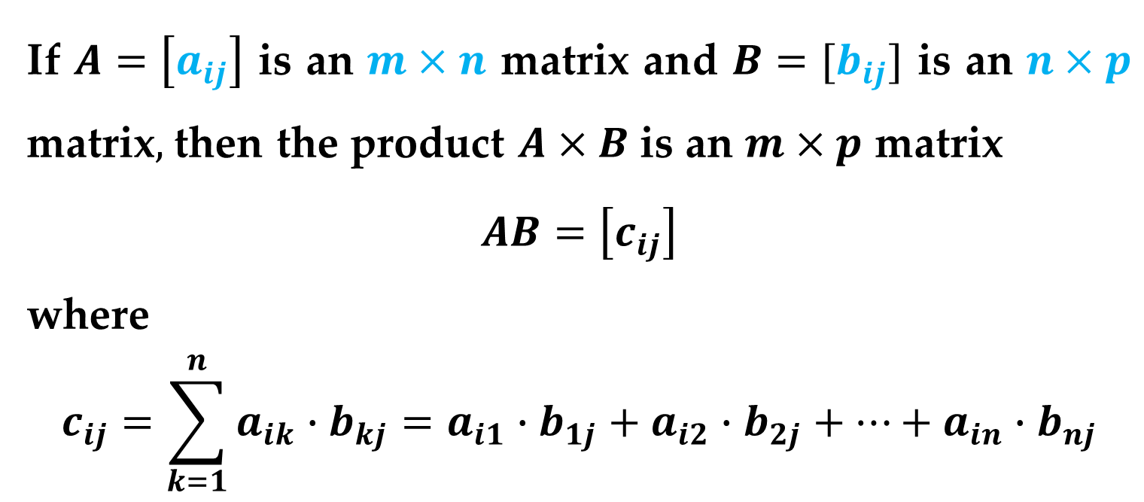
Definition (Matrix Multiplication)
If $A=\left[a_{ij}\right]$ is an $m×n$ matrix and $B=[b_{ij}]$ is an $n×p$ matrix$,$then the product $A×B$ is an $m×p$ matrix
$$AB=\left[c_{ij}\right]$$
where
$$c_{ij}=\sum_{k=1}^{n}{a_{ik}∙b_{kj}}=a_{i1}∙b_{1j}+a_{i2}∙b_{2j}+…+a_{in}∙b_{nj}$$
Matrix Multiplication

Slide 20
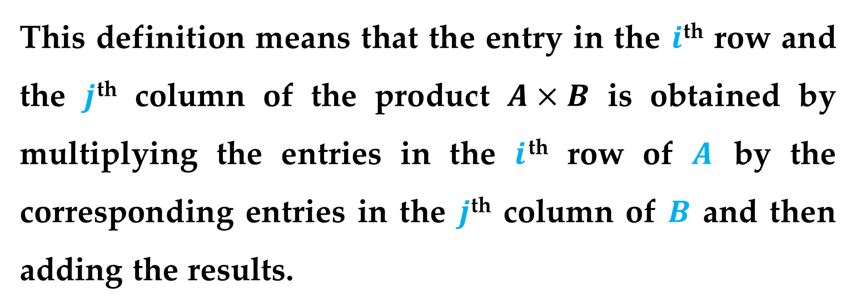
This definition means that the entry in the $i$^{th} row and the $j$^{th} column of the product $A×B$ is obtained by multiplying the entries in the $i$^{th} row of $A$ by the corresponding entries in the $j$^{th} column of $B$ and then adding the results.
Matrix Multiplication

Slide 21
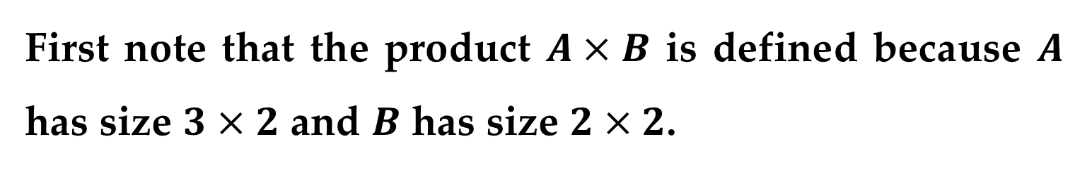
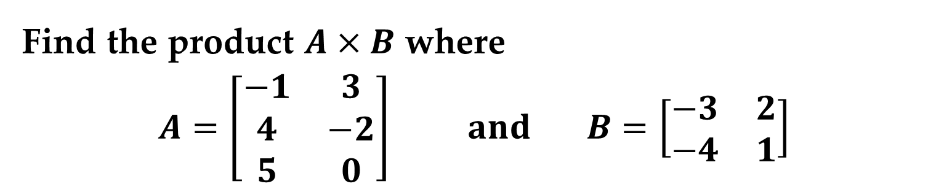
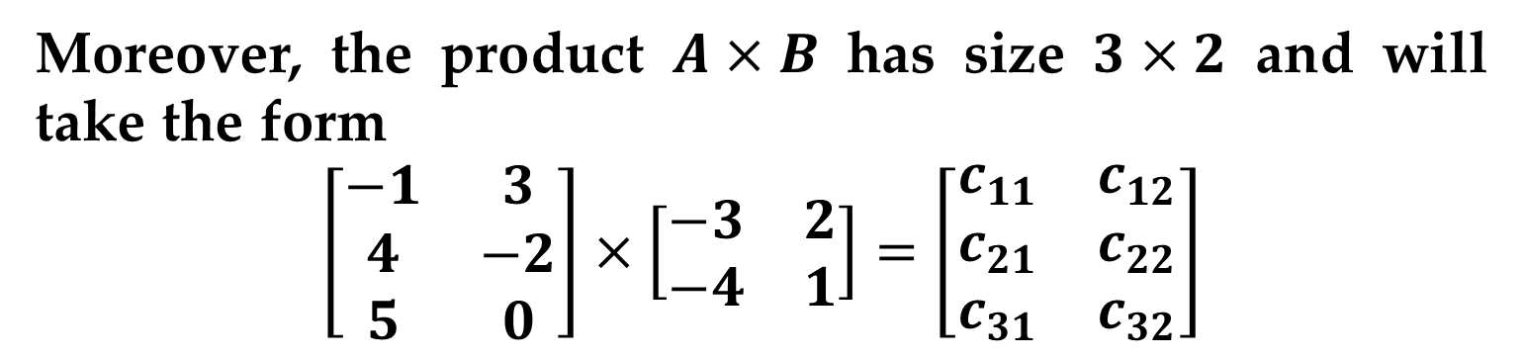
Example 4. Finding the Product of Two Matrices
Find the product $A×B$ where
$$A=\left[\begin{matrix}−1 & 3 \\ 4 & −2 \\ 5 & 0\end{matrix}\right] and B=\left[\begin{matrix}−3 & 2 \\ −4 & 1\end{matrix}\right]$$
Solution
First note that the product $A×B$ is defined because $A$ has size $3×2$ and $B$ has size $2×2$.
Moreover, the product $A×B$ has size $3×2$ and will take the form
$$\left[\begin{matrix}−1 & 3 \\ 4 & −2 \\ 5 & 0\end{matrix}\right]×\left[\begin{matrix}−3 & 2 \\ −4 & 1\end{matrix}\right]=\left[\begin{matrix}c_{11} & c_{12} \\ c_{21} & c_{22} \\ c_{31} & c_{32}\end{matrix}\right]$$
Matrix Multiplication

Slide 22
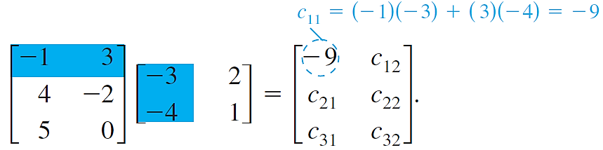
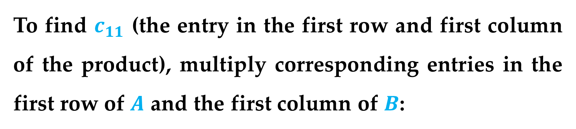
Solution (continued)
To find $c_{11}$ (the entry in the first row and first column of the product), multiply corresponding entries in the first row of $A$ and the first column of $B$:
Matrix Multiplication

Slide 23
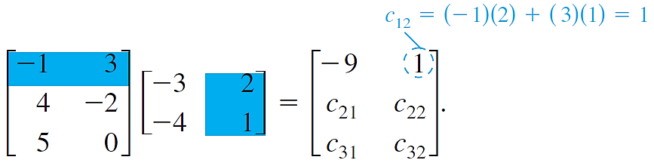
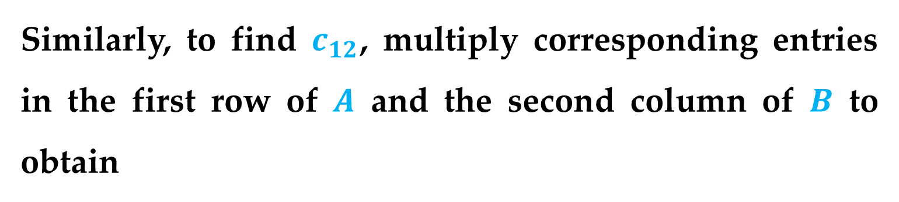
Solution (continued)
Similarly, to find $c_{12}$, multiply corresponding entries in the first row of $A$ and the second column of $B$ to obtain
Matrix Multiplication

Slide 24
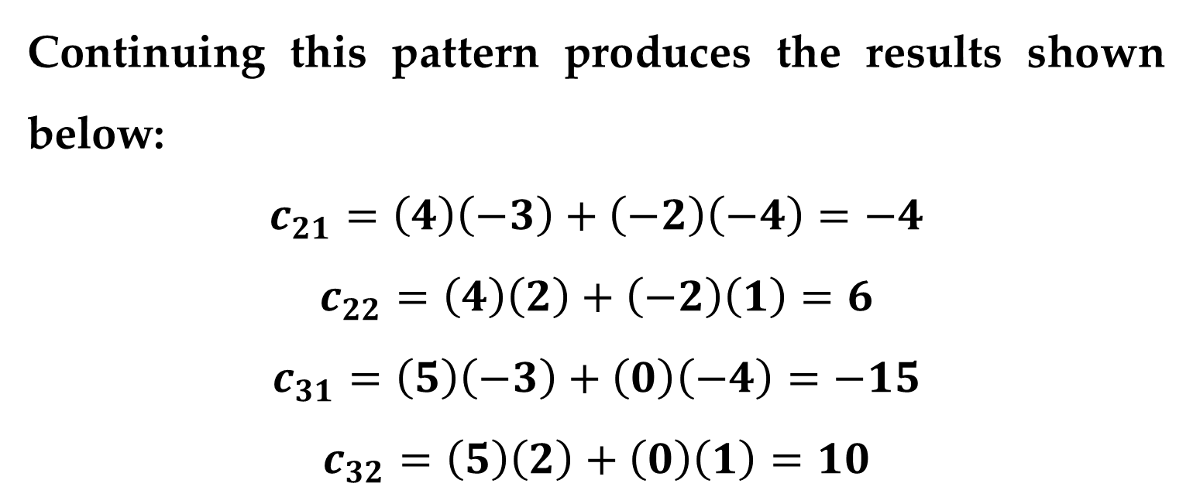
Solution (continued)
Continuing this pattern produces the results shown below:
$$c_{21}=\left(4\right)\left(−3\right)+\left(−2\right)\left(−4\right)=−4$$
$$c_{22}=\left(4\right)\left(2\right)+\left(−2\right)\left(1\right)=6$$
$$c_{31}=\left(5\right)\left(−3\right)+\left(0\right)\left(−4\right)=−15$$
$$c_{32}=\left(5\right)\left(2\right)+\left(0\right)\left(1\right)=10$$
Matrix Multiplication

Slide 25
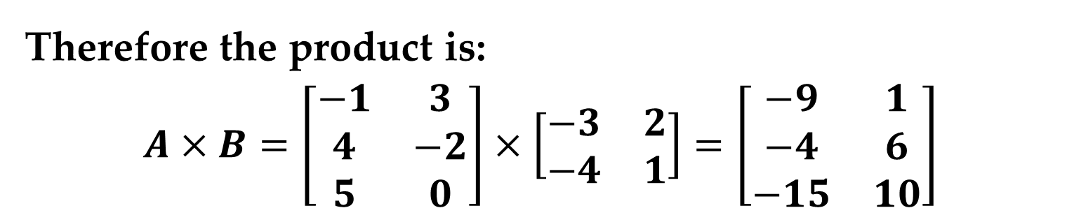
Solution (continued)
Therefore the product is:
$$A×B=\left[\begin{matrix}−1 & 3 \\ 4 & −2 \\ 5 & 0\end{matrix}\right]×\left[\begin{matrix}−3 & 2 \\ −4 & 1\end{matrix}\right]=\left[\begin{matrix}−9 & 1 \\ −4 & 6 \\ −15 & 10\end{matrix}\right]$$
Matrix Multiplication

Slide 26
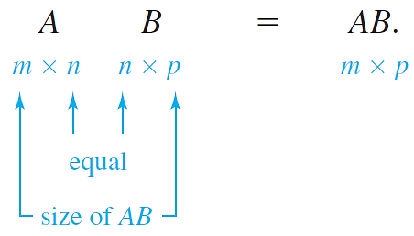
Remark
For the product of two matrices to be defined, the number of columns of the first matrix must equal the number of rows of the second matrix:
Matrix Multiplication

Slide 27
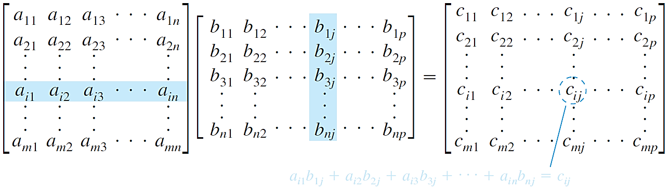
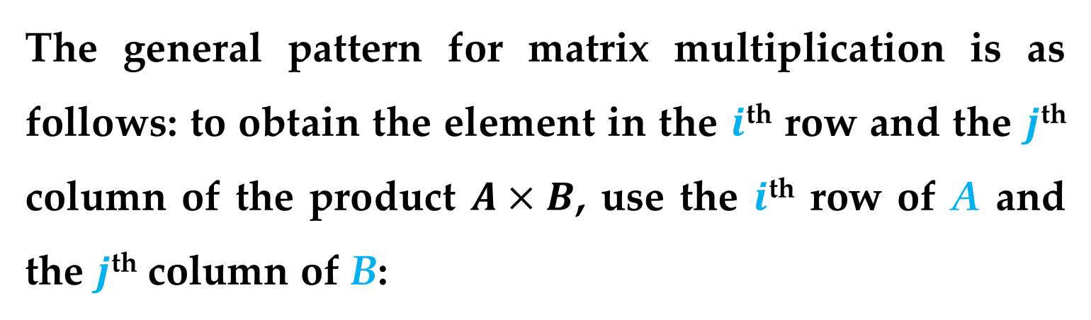
The general pattern for matrix multiplication is as follows: to obtain the element in the $i$^{th} row and the $j$^{th} column of the product $A×B$, use the $i$^{th} row of A and the $j$^{th} column of B:
Matrix Multiplication

Slide 28
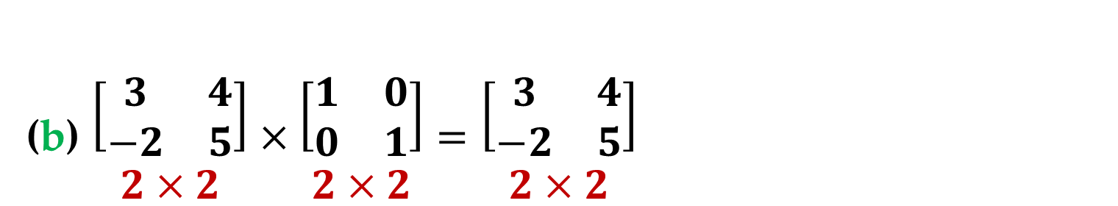
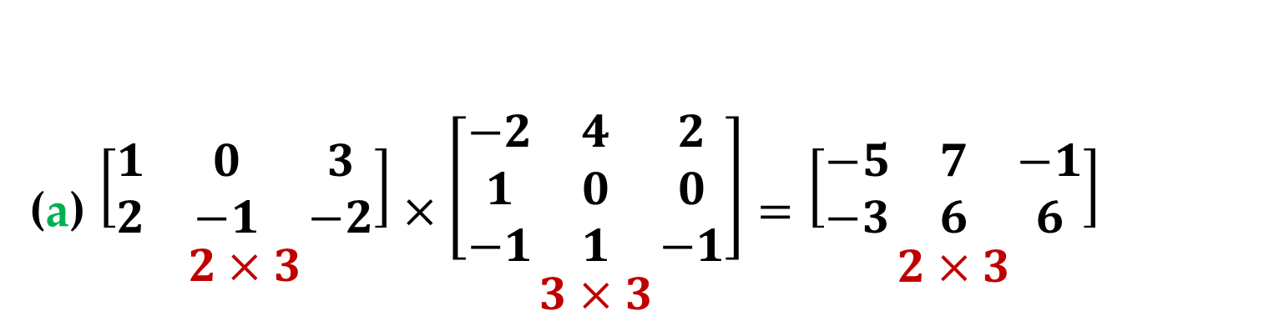
Example 5. Matrix Multiplication
(a) $\begin{matrix}\left[\begin{matrix}1 & 0 & 3 \\ 2 & −1 & −2\end{matrix}\right] \\ 2×3\end{matrix}×\begin{matrix}\left[\begin{matrix}−2 & 4 & 2 \\ 1 & 0 & 0 \\ −1 & 1 & −1\end{matrix}\right] \\ 3×3\end{matrix}=\begin{matrix}\left[\begin{matrix}−5 & 7 & −1 \\ −3 & 6 & 6\end{matrix}\right] \\ 2×3\end{matrix}$
(b) $\begin{matrix}\left[\begin{matrix}3 & 4 \\ −2 & 5\end{matrix}\right] \\ 2×2\end{matrix}×\begin{matrix}\left[\begin{matrix}1 & 0 \\ 0 & 1\end{matrix}\right] \\ 2×2\end{matrix}=\begin{matrix}\left[\begin{matrix}3 & 4 \\ −2 & 5\end{matrix}\right] \\ 2×2\end{matrix}$
Matrix Multiplication

Slide 29
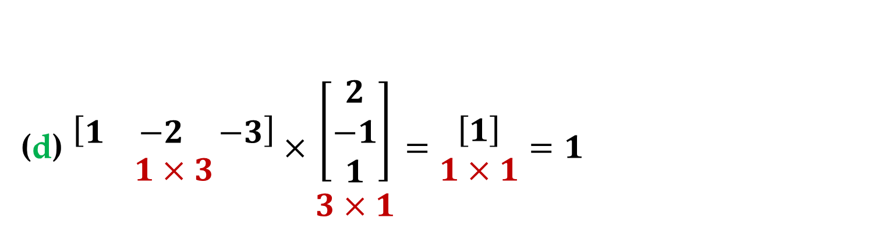
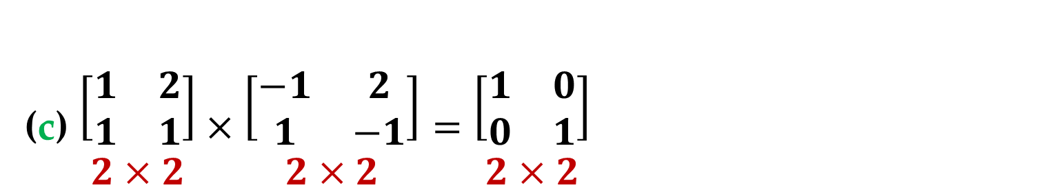
Example 5. Matrix Multiplication
(c) $\begin{matrix}\left[\begin{matrix}1 & 2 \\ 1 & 1\end{matrix}\right] \\ 2×2\end{matrix}×\begin{matrix}\left[\begin{matrix}−1 & 2 \\ 1 & −1\end{matrix}\right] \\ 2×2\end{matrix}=\begin{matrix}\left[\begin{matrix}1 & 0 \\ 0 & 1\end{matrix}\right] \\ 2×2\end{matrix}$
(d) $\begin{matrix}\left[\begin{matrix}1 & −2 & −3\end{matrix}\right] \\ 1×3\end{matrix}×\begin{matrix}\left[\begin{matrix}2 \\ −1 \\ 1\end{matrix}\right] \\ 3×1\end{matrix}=\begin{matrix}\left[1\right] \\ 1×1\end{matrix}=1$
Matrix Multiplication

Slide 30
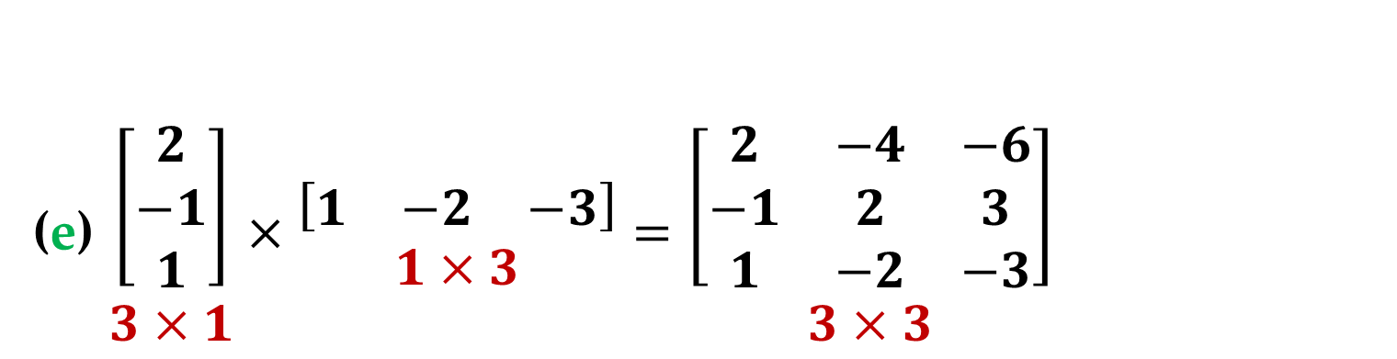
Example 5. Matrix Multiplication
(e) $\begin{matrix}\left[\begin{matrix}2 \\ −1 \\ 1\end{matrix}\right] \\ 3×1\end{matrix}×\begin{matrix}\left[\begin{matrix}1 & −2 & −3\end{matrix}\right] \\ 1×3\end{matrix}=\begin{matrix}\left[\begin{matrix}2 & −4 & −6 \\ −1 & 2 & 3 \\ 1 & −2 & −3\end{matrix}\right] \\ 3×3\end{matrix}$
Matrix Multiplication

Slide 31
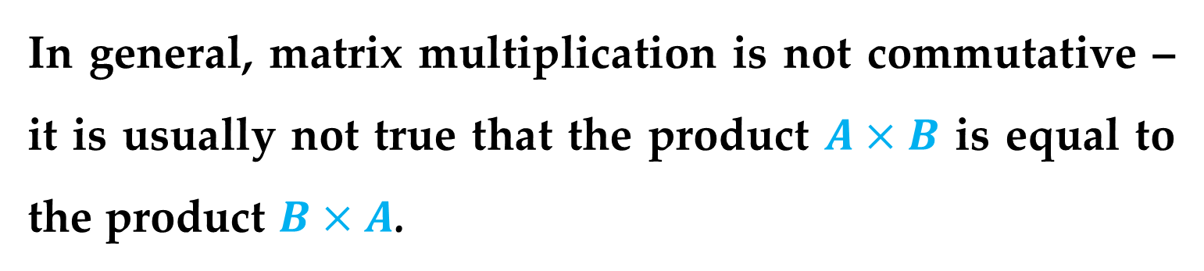
Remark
In general, matrix multiplication is not commutative – it is usually not true that the product $A×B$ is equal to the product $B×A$.
Matrix Multiplication

Slide 32
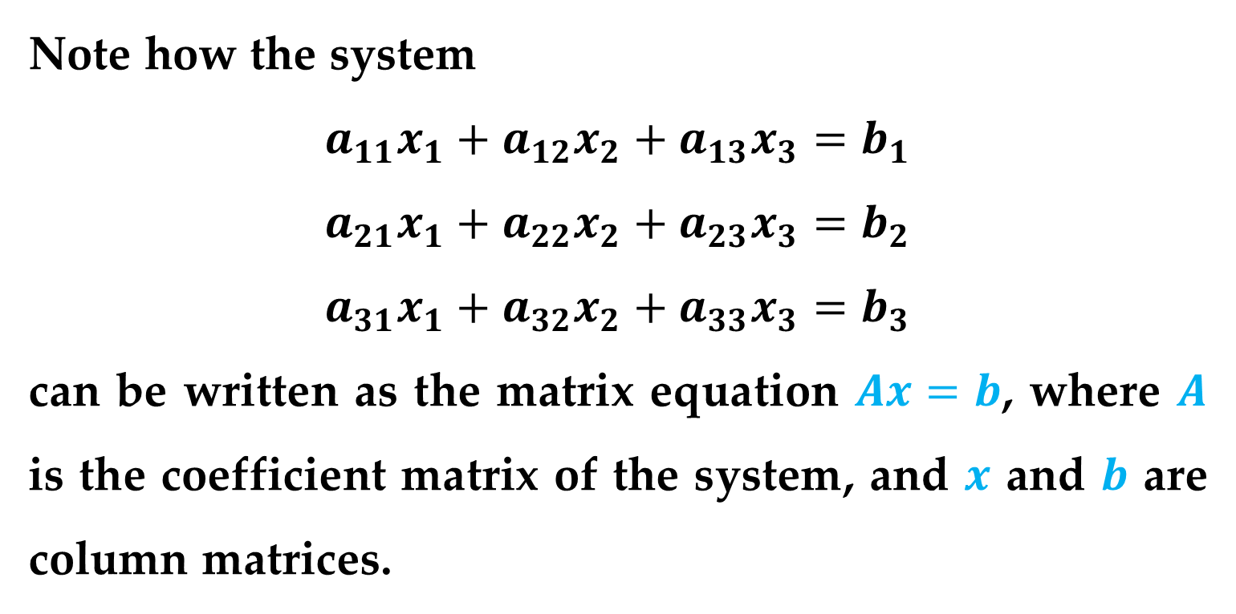
One practical application of matrix multiplication is representing a system of linear equations.
Note how the system
$$a_{11}x_{1}+a_{12}x_{2}+a_{13}x_{3}=b_{1}$$
$$a_{21}x_{1}+a_{22}x_{2}+a_{23}x_{3}=b_{2}$$
$$a_{31}x_{1}+a_{32}x_{2}+a_{33}x_{3}=b_{3}$$
can be written as the matrix equation $Ax=b$, where $A$ is the coefficient matrix of the system, and $x$ and $b$ are column matrices.
Systems of Linear Equations

Slide 33
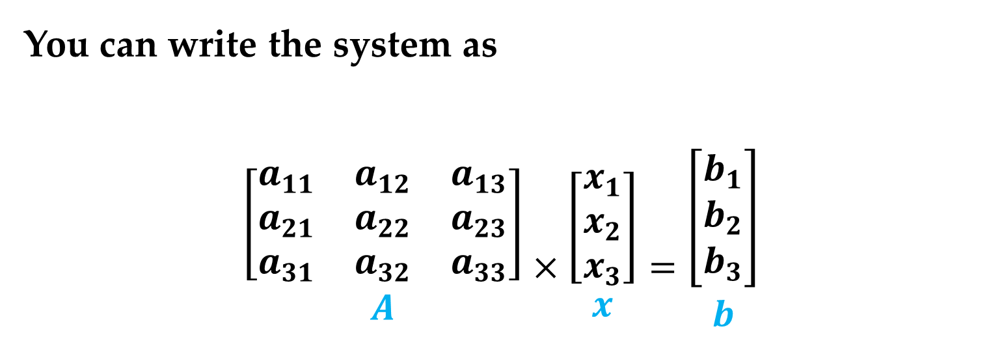
You can write the system as
$${\left[\begin{matrix}a_{11} & a_{12} & a_{13} \\ a_{21} & a_{22} & a_{23} \\ a_{31} & a_{32} & a_{33}\end{matrix}\right] \atop A}×{\left[\begin{matrix}x_{1} \\ x_{2} \\ x_{3}\end{matrix}\right] \atop x}={\left[\begin{matrix}b_{1} \\ b_{2} \\ b_{3}\end{matrix}\right] \atop b}$$
Systems of Linear Equations

Slide 34
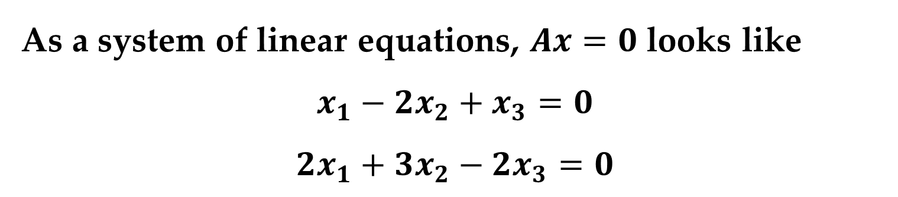

Example 6. Solving a System of Linear Equations
Solve the matrix equation $Ax=0$, where
$$A=\left[\begin{matrix}1 & −2 & 1 \\ 2 & 3 & −2\end{matrix}\right], x=\left[\begin{matrix}x_{1} \\ x_{2} \\ x_{3}\end{matrix}\right], 0=\left[\begin{matrix}0 \\ 0\end{matrix}\right]$$
Solution
As a system of linear equations, $Ax=0$ looks like
$$x_{1}−2x_{2}+x_{3}=0$$
$$2x_{1}+3x_{2}−2x_{3}=0$$
Systems of Linear Equations

Slide 35


Solution (continued)
Using Gauss-Jordan elimination on the augmented matrix of this system, you obtain
$$\left[\begin{matrix}\begin{matrix}1 & 0 & −\frac{1}{7} \\ 0 & 1 & −\frac{4}{7}\end{matrix} & \begin{matrix}0 \\ 0\end{matrix}\end{matrix}\right]$$
So, the system has an infinite number of solutions defined by the parametric form
$$x_{1}=t, x_{2}=4t, x_{3}=7t$$
where $t$ is any real number.
Systems of Linear Equations

Slide 36


Solution (continued)
In matrix terminology, you have found that the matrix equation
$$\left[\begin{matrix}1 & −2 & 1 \\ 2 & 3 & −2\end{matrix}\right]×\left[\begin{matrix}x_{1} \\ x_{2} \\ x_{3}\end{matrix}\right]=\left[\begin{matrix}0 \\ 0\end{matrix}\right]$$
has an infinite number of solutions represented by
$$x=\left[\begin{matrix}x_{1} \\ x_{2} \\ x_{3}\end{matrix}\right]=\left[\begin{matrix}t \\ 4t \\ 7t\end{matrix}\right]=t\left[\begin{matrix}1 \\ 4 \\ 7\end{matrix}\right]$$
That is, any scalar multiple of the column matrix on the right is a solution.
Systems of Linear Equations

Slide 37


The system $Ax=b$ can be represented in a more convenient way by partitioning the matrices $A$ and $x$ in the following manner.
Assume that
$$A=\left[\begin{matrix}\begin{matrix}a_{11} & a_{12} \\ a_{21} & a_{22}\end{matrix} & \begin{matrix}⋯ & a_{1n} \\ ⋯ & a_{2n}\end{matrix} \\ \begin{matrix}⋮ & ⋮ \\ a_{m1} & a_{m2}\end{matrix} & \begin{matrix}⋮ & ⋮ \\ ⋯ & a_{mn}\end{matrix}\end{matrix}\right], x=\left[\begin{matrix}x_{1} \\ x_{2} \\ \begin{matrix}⋮ \\ x_{n}\end{matrix}\end{matrix}\right], b=\left[\begin{matrix}b_{1} \\ b_{2} \\ \begin{matrix}⋮ \\ b_{n}\end{matrix}\end{matrix}\right]$$
are the coefficient matrix, the column matrix of unknowns, and the right-hand side, respectively.
Partitioned Matrices

Slide 38


The $m×n$ linear system $Ax=b$ can then be written as
$$\begin{matrix}Ax=b \\ \left[\begin{matrix}\begin{matrix}a_{11} & a_{12} \\ a_{21} & a_{22}\end{matrix} & \begin{matrix}⋯ & a_{1n} \\ ⋯ & a_{2n}\end{matrix} \\ \begin{matrix}⋮ & ⋮ \\ a_{m1} & a_{m2}\end{matrix} & \begin{matrix}⋮ & ⋮ \\ ⋯ & a_{mn}\end{matrix}\end{matrix}\right]\left[\begin{matrix}x_{1} \\ x_{2} \\ \begin{matrix}⋮ \\ x_{n}\end{matrix}\end{matrix}\right]=b\end{matrix}$$
$$\left[\begin{matrix}a_{11}x_{1}+a_{12}x_{2}+…+a_{1n}x_{n} \\ a_{21}x_{1}+a_{22}x_{2}+…+a_{2n}x_{n} \\ \begin{matrix}⋮ \\ a_{m1}x_{1}+a_{m2}x_{2}+…+a_{mn}x_{n}\end{matrix}\end{matrix}\right]=b$$
Partitioned Matrices

Slide 39


$$x_{1}\left[\begin{matrix}a_{11} \\ a_{21} \\ \begin{matrix}⋮ \\ a_{m1}\end{matrix}\end{matrix}\right]+x_{2}\left[\begin{matrix}a_{12} \\ a_{22} \\ \begin{matrix}⋮ \\ a_{m2}\end{matrix}\end{matrix}\right]+…+x_{n}\left[\begin{matrix}a_{1n} \\ a_{2n} \\ \begin{matrix}⋮ \\ a_{mn}\end{matrix}\end{matrix}\right]=b$$
In other words:
$$Ax=x_{1}a_{1}+x_{2}a_{2}+…+x_{n}a_{n}=b$$
where $a_{1},a_{2},…,a_{n}$ are the columns of the matrix $A$.
Partitioned Matrices

Slide 40

The expression
$$x_{1}\left[\begin{matrix}a_{11} \\ a_{21} \\ \begin{matrix}⋮ \\ a_{m1}\end{matrix}\end{matrix}\right]+x_{2}\left[\begin{matrix}a_{12} \\ a_{22} \\ \begin{matrix}⋮ \\ a_{m2}\end{matrix}\end{matrix}\right]+…+x_{n}\left[\begin{matrix}a_{1n} \\ a_{2n} \\ \begin{matrix}⋮ \\ a_{mn}\end{matrix}\end{matrix}\right]$$
is called a linear combination of the column matrices $a_{1},a_{2},…,a_{n}$ with coefficients $x_{1},x_{2},…,x_{n}$.
Partitioned Matrices

Slide 41


Example 7. Solving a System of Linear Equations
Solve the linear system:
$$x_{1}+2x_{2}+3x_{3}=0$$
$$4x_{1}+5x_{2}+6x_{3}=3$$
$$7x_{1}+8x_{2}+9x_{3}=6$$
Solution
This linear system can be rewritten as a matrix equation as follows:
$$x_{1}\left[\begin{matrix}1 \\ 4 \\ 7\end{matrix}\right]+x_{2}\left[\begin{matrix}2 \\ 5 \\ 8\end{matrix}\right]+x_{3}\left[\begin{matrix}3 \\ 6 \\ 9\end{matrix}\right]=\left[\begin{matrix}0 \\ 3 \\ 6\end{matrix}\right]$$
Partitioned Matrices

Slide 42


Solution (continued)
Using Gaussian elimination, you can show that this system has an infinite number of solutions, one of which is
$$x_{1}=1,x_{2}=1,x_{3}=−1$$
This solution can be verified as follows:
$$1\left[\begin{matrix}1 \\ 4 \\ 7\end{matrix}\right]+1\left[\begin{matrix}2 \\ 5 \\ 8\end{matrix}\right]+\left(−1\right)\left[\begin{matrix}3 \\ 6 \\ 9\end{matrix}\right]=\left[\begin{matrix}1+2−3 \\ 4+5−6 \\ 7+8−9\end{matrix}\right]=\left[\begin{matrix}0 \\ 3 \\ 6\end{matrix}\right]$$
Partitioned Matrices

Slide 43

Solution (continued)
That is, $b$ can be expressed as a linear combination of the columns of $A$.
This representation of one column vector in terms of others is a fundamental theme of linear algebra.
Partitioned Matrices

Slide 44

Remark
A matrix could also be partitioned into row matrices as follows:
$$\left[\begin{matrix}\begin{matrix}1 & 2 & 0 \\ 3 & 4 & 0 \\ −1 & −2 & 2\end{matrix} & \begin{matrix}0 \\ 0 \\ 1\end{matrix}\end{matrix}\right]=\left[\begin{matrix}r_{1} \\ r_{2} \\ r_{3}\end{matrix}\right]$$
where
$$r_{1}=\left[\begin{matrix}1 & 2 & \begin{matrix}0 & 0\end{matrix}\end{matrix}\right]$$
$$r_{2}=\left[\begin{matrix}3 & 4 & \begin{matrix}0 & 0\end{matrix}\end{matrix}\right]$$
$$r_{3}=\left[\begin{matrix}−1 & −2 & \begin{matrix}2 & 1\end{matrix}\end{matrix}\right]$$
Partitioned Matrices

Slide 45
Thank You for Attention

